Slide 1



Capgemini
CONS U LT I NG. TECHNOLOGY. 0 UT SOU RC I NG
People matter� results
count.
Fresher Learning Program
Teradata Training – FastLoad
Location, Date, Author

Slide 2

Module
Object
▪
Introduction about Teradata Utility
▪
Introduction to Fast Load
▪
Supporting Environment
▪
Key requirements for Fast Load
▪
Basic steps for Fast Load
▪
Loading Phase
▪
Simple Fast Load Script
▪
BEGIN LOADING Statement
▪
END LOADING Statement
▪
INSERT Statement
▪
Data Type Conversion in Fast Load
▪
Fast Load Restartibilty
▪
Fast Load Command
Presentation Title | Date
Copyright © Capgemini 2015. All Rights Reserved 2

Slide 3
Introduction about Teradata Utility
What is the need of Teradata utilities in Data ware house
➢Quick access to data for more timely decision making.
➢Solutions for the entire spectrum of load requirements from batch to near real time.
➢Unmatched scalability for large volume loads.
➢Fail-proof loads with checkpoint restart capabilities.
➢Proven technology from the data warehouse technology leader.
➢Integration with industry-leading ETL and ELT tools.
Teradata Utilities :
BTEQ: Help for Report formatting, Ad hoc query tool, Database administration, Best for small data volumes
Multi Load :High-performance data unload in client format.
Fast Load: High-performance initial table load.
Multi Load: High-performance maintenance operations applies updates to multiple tables in single pass.
Apart from these teradata having other utilities like Teradata Parallel Transporter, Tpump e.t.c.
Presentation Title | Date
Copyright © Capgemini 2015. All Rights Reserved 3

Slide 4
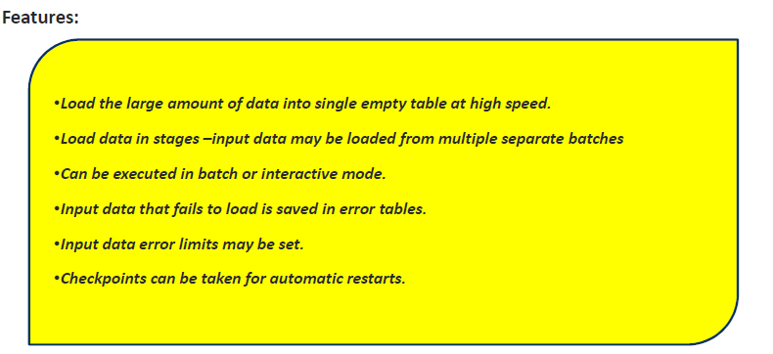
Introduction to Fast Load
Why the Name “Fast” Load:
▪
Fast Load is known for its high speed in loading the large amounts of data from files to empty
Teradata tables .This speed is achieved because it does not use the Transient Journal. Apart from these there are some other logical reasons behind this ,which makes it fast, basically it was developed to load millions of rows into a table.
Presentation Title | Date
Copyright © Capgemini 2015. All Rights Reserved 4

Slide 5



Introduction
to
Fast
Load
• The Target table must initia.lly empty.
• The target table can not have Secondary lndexes(USI/NUSI),join
indexes, or Has Indexes
• Referential lnteg·rity constraints are not supported.
• The target tab.le can not have Enabled Triggers.
-Duplicate rows are not loaded into target tpble(even if the table is MULTISET).
• if an AMP goes down,
Fastload can not be restarted until the A MP is back online.
Capgemmi
CON 5 ULT I NG. TECH NOL O G Y. 0 UT 5 0 UR CI NG
Presentation Title | Date
Copyright © Capgemini 2015. All Rights Reserved 5

Slide 6
Supporting Environment
The Fast Load utility is supported either on either the mainframe or on network attached system(LAN)
The LAN environment supports the following Operating Systems:
•UNIX MP-RAS
•Windows 2000
•Windows 95
•Windows NT
•UNIX HP-UX
•AIX
•Solaris SPARC
•Solaris Intel
The Mainframe (Channel Attached) environment supports the following Operating Systems:
• MVS
• VM
Fast Load perform so well when it is loading millions or even billions of rows in any environment. The reason behind is
•Fast Load assembles data into 64K blocks (64,000 bytes) to load it and can use multiple sessions simultaneously.
•Fast Load taking the advantage of parallel processing.
Presentation Title | Date
Copyright © Capgemini 2015. All Rights Reserved 6

Slide 7
Key requirements for Fast Load
Fast Load can be run from either MVS/ Channel (mainframe) or Network (LAN) host. In either case, Fast Load requires three key
components.
Log Table
▪
Fast Load needs a place to record information on its progress during a load. It uses the table called Fast log in the SYSADMIN
▪
database. This table contains one row for every Fast Load running on the system. In order for your FastLoad to use this table,
▪
you need INSERT, UPDATE and DELETE privileges on that table.
Empty Target Table
▪
We have already mentioned the absolute need for the target table to be empty.
Two Error Tables.
▪
Each Fast Load requires two error tables. These are error tables that will only be populated should errors occur during the load
▪
process. These are required by the Fast Load utility, which will automatically create.
▪
The first error table is for any translation errors or constraint violations.
▪
( For example, a row with a column containing a wrong data type would be reported to the first error table.)
▪
The second error table is for errors caused by duplicate values for Unique Primary Indexes (UPI).
▪
Fast Load will load just one occurrence for every UPI. The other occurrences will be stored in this table. However, if the entire row is
▪
a duplicate, Fast Load counts it but does not store the row. These tables may be analyzed later for troubleshooting should errors
▪
occur during the load. For specifics on how you can troubleshoot, see the section below titled, "What Happens When Fast Load
▪
Finishes.”
Presentation Title | Date
Copyright © Capgemini 2015. All Rights Reserved 7

Slide 8



Basic steps for Fast
Load
Before run the Fast load Script , below points should be keep in mind.
,
Logging onto Teradata
,
Defining the Teradata table that you want to load (target table)
,
Defining the INPUT data file
,
Telling the system to Start loading
,
Telling the system to End loading
As we defined in kev requirement section Empty Teradata table is required to load the data.
Required the source information file, \lvhere the data is going to load.
Start loading and End Loading is happened through two phases called as
» Acq uisirUo rn Pha s.e (:Phase ·1)
» Ap pl]j catti o n/'E nd L.o·ad ilng/S·ort Phase(P has e2 J
Capgemmi
CON 5 ULT I NG. TECH NOL O G Y. 0 UT 5 0 UR CI NG
Presentation Title | Date
Copyright © Capgemini 2015. All Rights Reserved 8

Slide 9



Acquisition Phase
For each Fastl.oad job, there are two SQl. sessions, one for handling SQL requests and the other for handling
log
table re start-related operations. There are also load sessions, established for each Fastload job that can
specified in a Fastl.oad script via the SESSIONS command.
be
Steps foUows, i1n Phaser
,Establishes two Parsing Engine SQL sessions and one or more Load Session on AMPs
(depending on the SESSIONS parameter).
,Fast Load sends blocks of records to Teradata.
,The .AMP de blocking task hashes each record in the block and
redistributes each row to the Message Passing Layer (PDE and BYNET).
,Every AMP will have a receiving task which collects the rows from the MPL.
,When enough rows are collected to fill a block in memory, the AMP writes the block to disk.
Capgemmi
CON 5 ULT I NG. TECH NOL O G Y. 0 UT 5 0 UR CI NG
Presentation Title | Date
Copyright © Capgemini 2015. All Rights Reserved 9

Slide 10

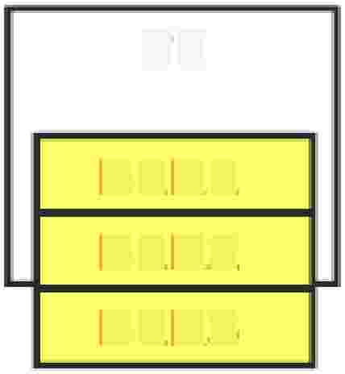
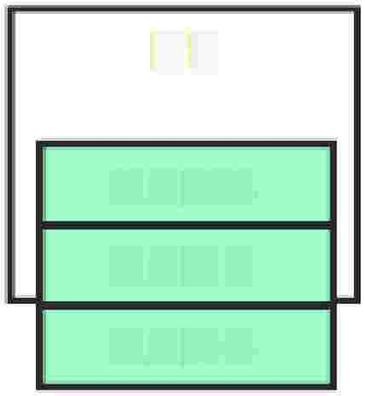

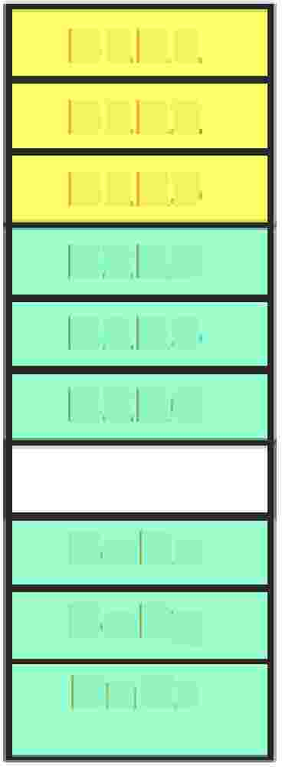
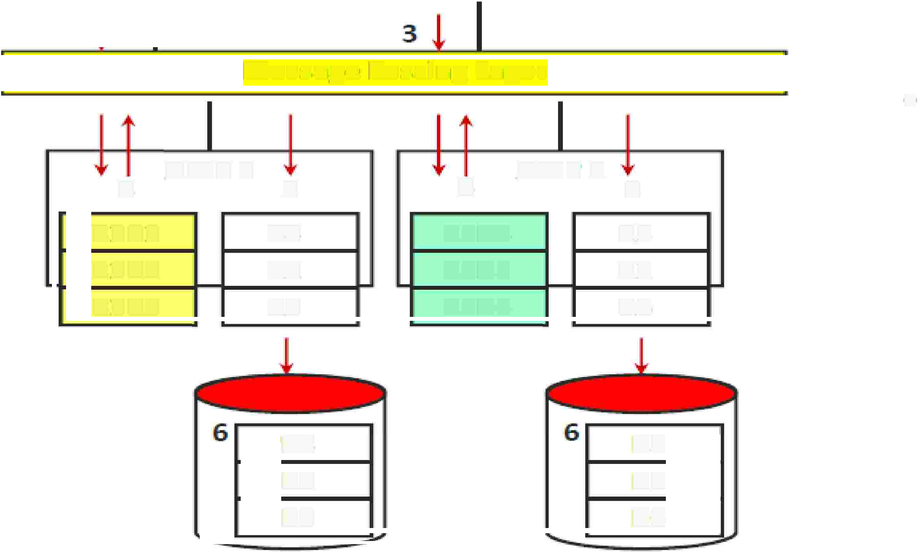

FastLoad
Phase
1
Host
Phase 1
Fast toad uses one SQIL session to define A.MP steps.
The PE sends a block to each AMP which stories blocks of unsorted data records,
AMPs hash each record and redistribute them to the AMP responsible for the hash value.
At the end of Phase 1,. each AMP has the rows it: should hav1e, but t hie rows. a re not in row hash sequence.
1-
Fas.t:Load
PE
PE
•
BlRl
B1R2
B1R3
B2R4
B2R5
B2R6
BlRl
B1R2
B1R3
B2R4
B2RS
B2R6
•·
I
•
Message Passing Layer
•·
BnRx
BnRy
BnRz
4
BlRl
B1R2
B1R3
AMP1
5
R4·
R2
RS
4
B2R4
B2RS
B2R6
AMP2
5
R3
Rl
R6,
R4
R2
RS
R3
R1
R6
Capgemmi
CON 5 ULT I NG. TECH NOL O G Y. 0 UT 5 0 UR CI NG
Presentation Title | Date
Copyright © Capgemini 2015. All Rights Reserved 10

Slide 11




Loading Phase
r
The second phase of fastload has each AMP [in parallel] reading the data blocks from disk, sorting the data
rows based on row hash, and writing the blocks back out to PERM space.
,Fastload receives the END LOADING; statement. Fastload sends a request to the
Parsing Engine to indicate the start of Phase 2.
,The PE broadcasts the start of Phase 2 to all AMPs.
,Each AMP reads its blocks in from disk.
,Each AMP sorts its data rows based on row hash sequence.
,Each AMP writes the sorted blocks back to disk.
Capgemmi
CON 5 ULT I NG. TECH NOL O G Y. 0 UT 5 0 UR CI NG
Presentation Title | Date
Copyright © Capgemini 2015. All Rights Reserved 11

Slide 12






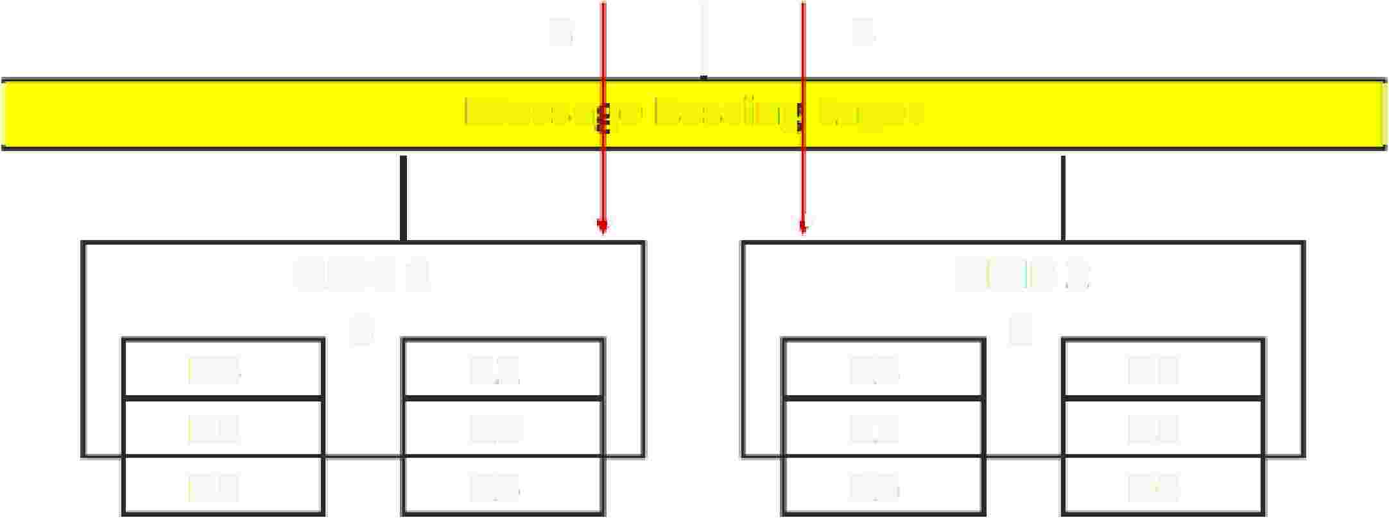



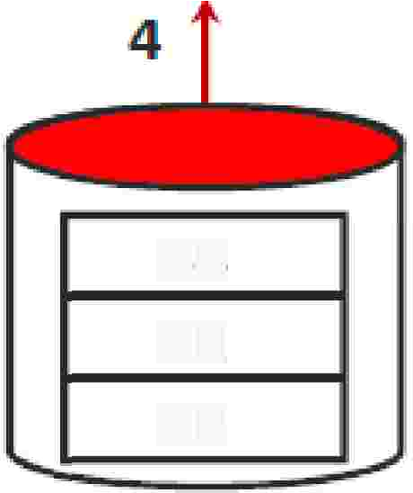
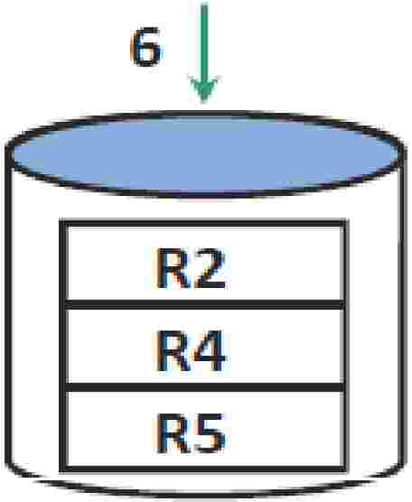
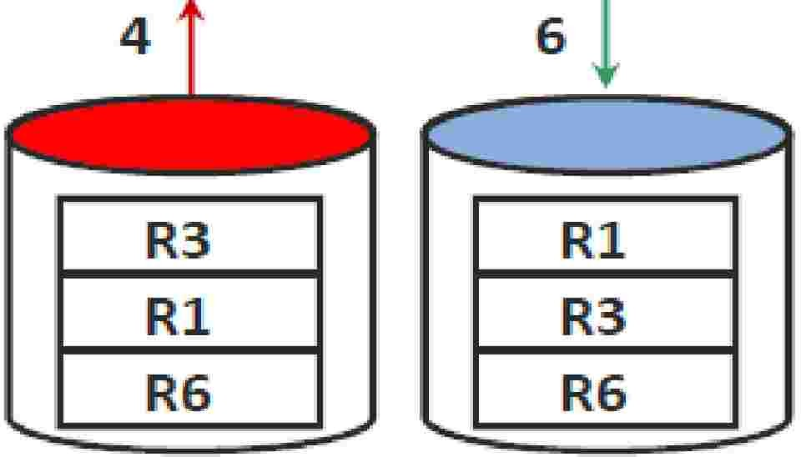

FastLoad
Phase
2
Host
1- Fastload
END LOADIING;
2.
PE
Phase 2
When tllhe Fastload job receives END LOADING; statement Fastload starts Phase 2.
•
3,
I
3
•
Ea,cllh AMP sorts the target table!' puts the rows into
blocks!' and wri1tes the blocks to disk.
I
Messa te Passing
Layer
I
'(
, ..
AMPl
5
I
AMP2.
.5,
•
Fall back rnws are then
generated i1f required.
R4
R2
RS
R2.
R4
RS
R3
Rl
R6,
I
Rl
R3
R6
I
I
•
Table data is ava i lable when
Phase 2 completes,
R4
R2
RS
Capgemmi
CON 5 ULT I NG. TECH NOL O G Y. 0 UT 5 0 UR CI NG
Presentation Title | Date
Copyright © Capgemini 2015. All Rights Reserved 12

Slide 13

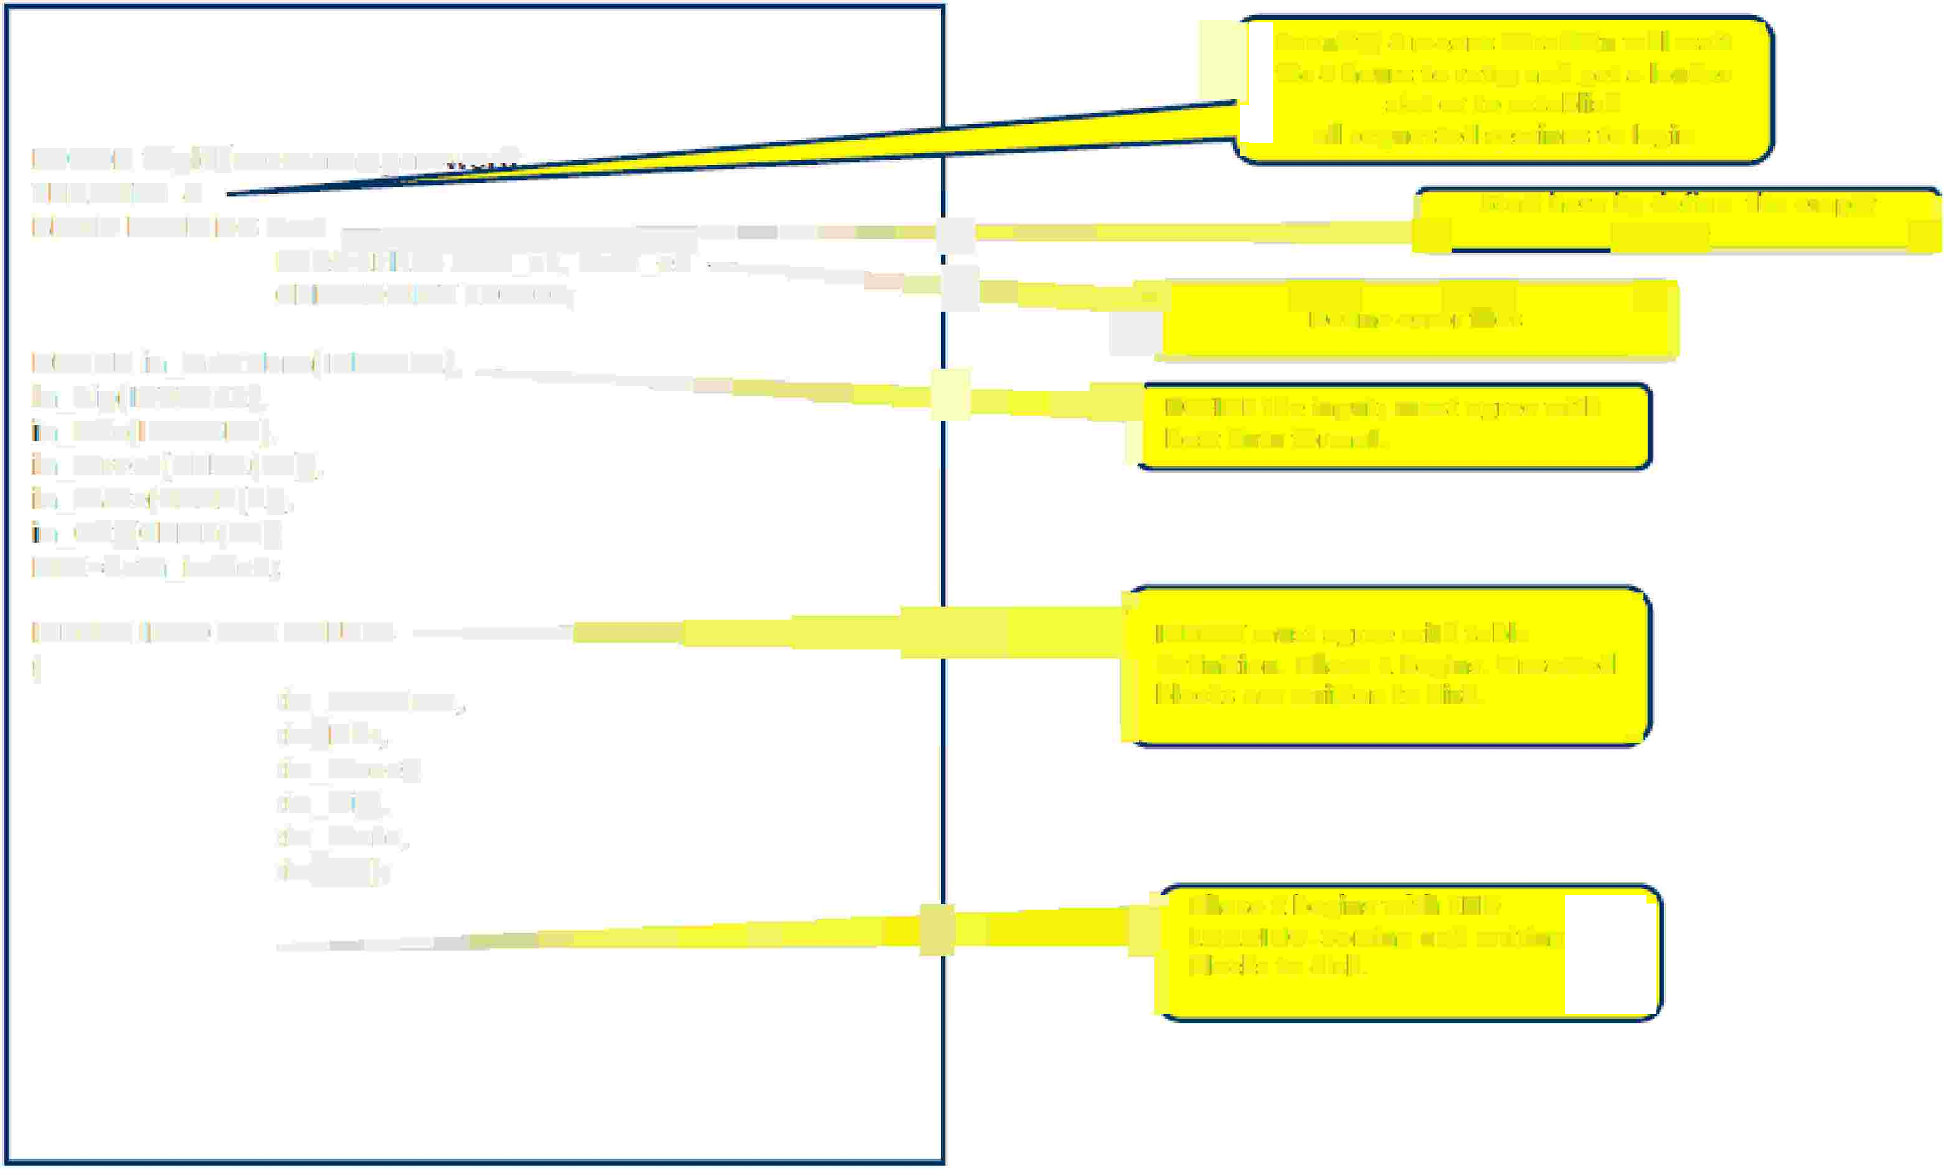



Simple Fast Load Script
J
Tenacity 4 means Teradata will wait ,
for 4 hours to retry and get a loader
slot or to establish
all requested sessions to llogin
LOGO N tdp:idJusemarne.,paiSS1L�m1r.nl ·
'\..
J
BEGIN LOADING Aut ===='°"������llllliii---===,=========:::::::==;._
I Start here by define the el'npt-;,
lElNACllY 4
ERIRORFIILES Acot_el.!' A.c,ct_e2 ·------�=t===:::::::::==�-----=-=-----:::-------,
�t�.!?!l�-----_J
OH EOKP-OINI 100000;
l⁻
]
DEJFIINE in_AcdNurn(IINTEGlrn}� -------11::;:;=======;::==== -------------
Define error files
:in_Zip[IINJEGER}�
"n_Nbr(INITIEGElR)i
in _Street(CHAR1{l5H,,
in _State [CHAR(2)),.
"n _Oity( OHAR(!S)I
FILI=data _infilel;
w DEFINE the input; must agree with I
l host data format.
-�======:::===r
l definition. Phase 1 begins. Unsorted
....
INSERT INTO AtttVALUES
1[
INSERT must agree with table
:im AcctN
lHTI,,
blocks are written to disk.
:im=Nbir,.
: in_str,ee�
:im_Cityr
:im stat,e,.
:im=Zip);.
�
------=================:::=====:;.I
,
El
NID l:OAID ING;
ll
PLOhaAsDeIN2 Gbe. gSoinrstinwgitahnEdNwIDriting bllocks to disk.
LOGO FF;
Capgemmi
CON 5 ULT I NG. TECH NOL O G Y. 0 UT 5 0 UR CI NG
Presentation Title | Date
Copyright © Capgemini 2015. All Rights Reserved 13

Slide 14
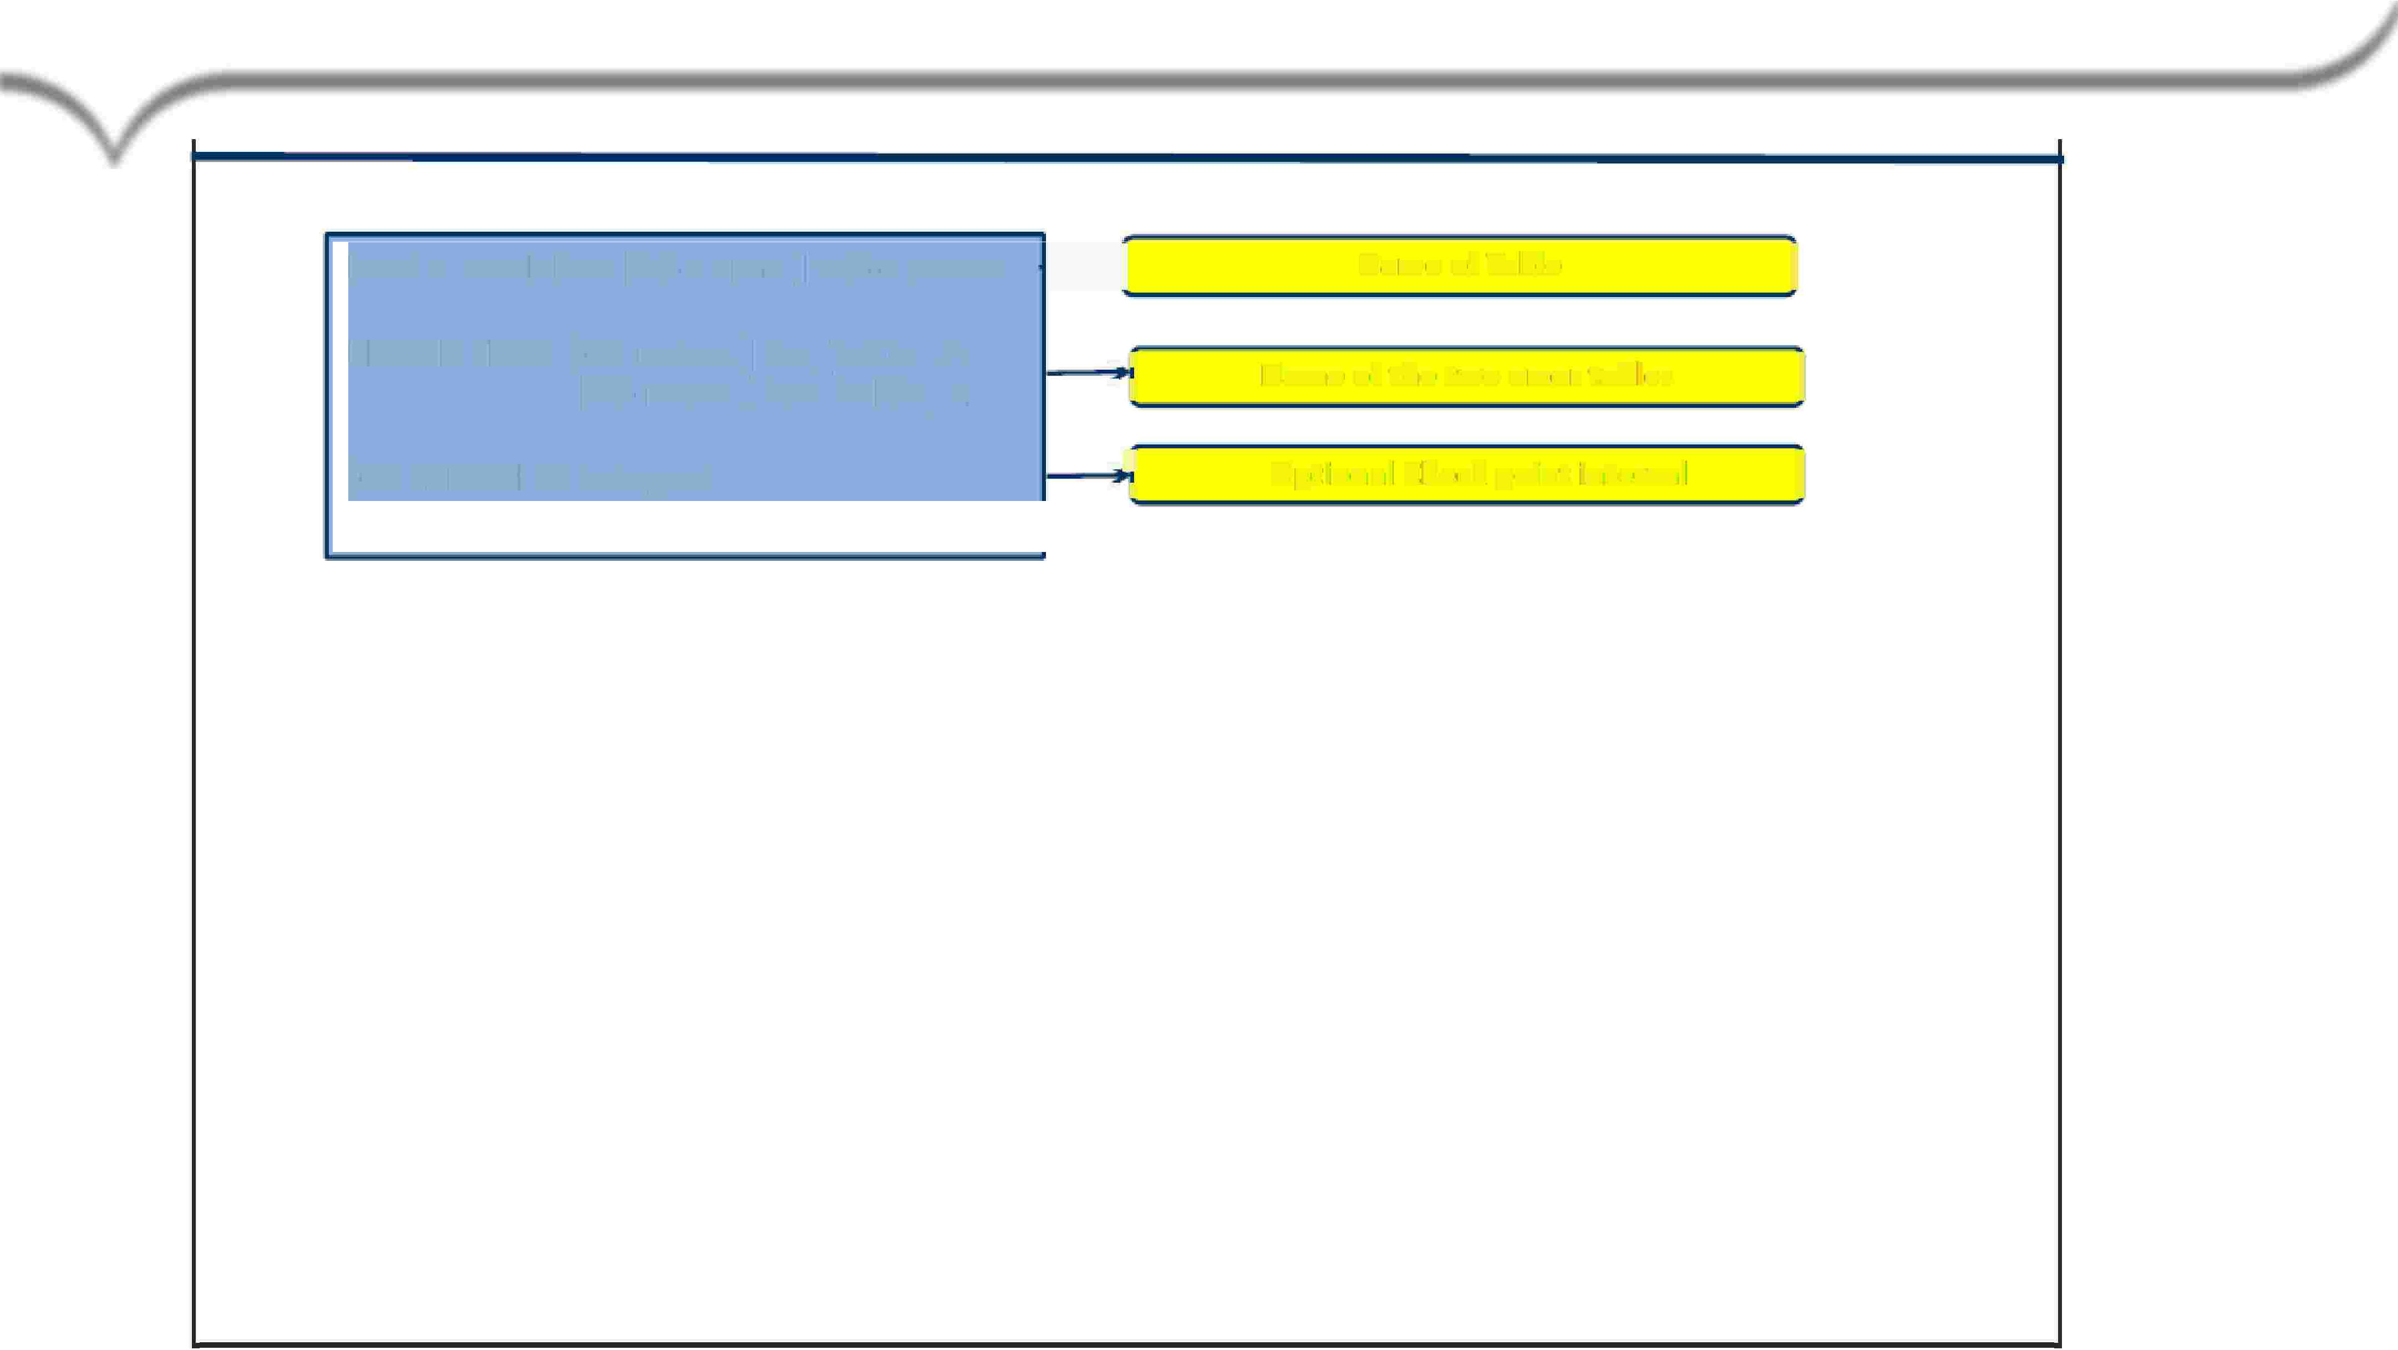


BEGIN
LOADING Statement
BEGIN LOADING [db name.] table name
�
Name of Table
I
ERROR FILES [db name.] Err_Table_l; [db name.] Err_Table_2;
... 1r
.. ll
Name of the two error tables
II
[CHECKPOINT integer]
...J
... ll
Optional Check point interval
11
User should have privileges i1r1 order to execute the fast load.
For Target Table: select and insertltreate,
Drop, 01r Delete i1f required )
For Error Table:
CRIEATE JAHLE
Capgemmi
CON 5 ULT I NG. TECH NOL O G Y. 0 UT 5 0 UR CI NG
Presentation Title | Date
Copyright © Capgemini 2015. All Rights Reserved 14

Slide 15











END LOADING Statement
1..-------------------iiiiiiiiiiiiiiiiiiiiiiiiiiiiiiiiiiiiiiiiiiiiiiiiiiiiiiill----.....!l!!l!!l!!l!!l!!l!!l!!l!!l!!l!!l!!l!!l!!l!!l!!l!!l!!l!!l!!l!!l!!l!!l!!l!!l!!l!!l!!l!
iiiiiiiiiiiiiiiiiiiiiiiiiiiiiiiiiiiiiiiiiiiiiiii�
END LOADING;
PII Table
, Indicates that al I data rows have been transmitted.
, Begins Phase 2 or Sort Phase processing.
,Omission implies:
• The load is incomplete and will be restarted later.
• This causes the table that is being loaded to become "Fastload paused,"
• If you attempt to access a table (via SQL) that is in a "Fastload paused"state, you will get the error.
NoP'I Table
,There is no Sort in Phase 2 for NoPI table. Phase 2 is very fast for a NoPI table.
,While a NoPI target table is being loaded , users can view the table with an ACCESS
Lock.This is possible because rows are always appended at the end of a NoPI table.
,The following SELECT will succeed for NoPI table.
LOCKING ROW FOR .ACCESS SELECT * FROM Orders_nopi;
Capgemmi
CON 5 ULT I NG. TECH NOL O G Y. 0 UT 5 0 UR CI NG
Presentation Title | Date
Copyright © Capgemini 2015. All Rights Reserved 15

Slide 16









INSERT
Statement
DE Fl IN.IE Acco uint:_N um beri(:I N TEG ER),
Nt11 mbe1f'l{IINITEG ER),
Sit1reet:( CHAR1(25) ), Ci't.y(CHAR(25) ),. Sitate1( CHAR (:2.) ), Zip_ Cod e(I NT'EGIER)
H LE = data_,fille3 ;
11 INISE RT I NITO Accou nits
(
Aocountt:_Number,
Nlt11mbeir,
Sit1reet:,
Ci't.V11
State,
Zip_Code
)
VALUES.
( :Acco u ntt:_IN umber,
:Number,
:Street,
:Cit�
:State,
:Zip_Gode);
The "wildcard'forrnat may be used to construct
the names in the INSERT statement.
The field names are constructed
from the D[)/D table definition.
DEFINE FILE= data_file3;
INSERT INTO Accounts.*;
Capgemmi
CON 5 ULT I NG. TECH NOL O G Y. 0 UT 5 0 UR CI NG
Presentation Title | Date
Copyright © Capgemini 2015. All Rights Reserved 16

Slide 17

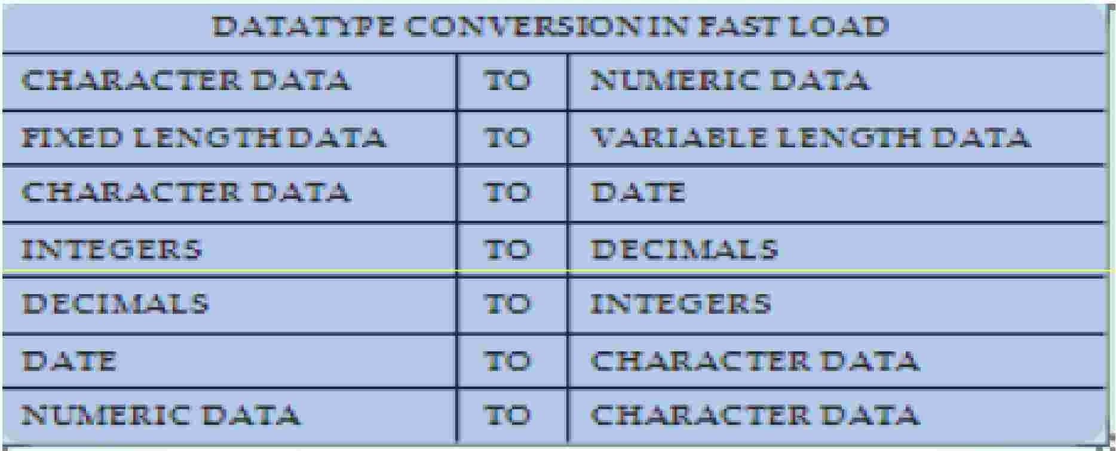

Data Type Conversion in Fast Load
Converting data is easy. Just define the input data types in the input file. Then, Fast Load willll compare that to
the column definitions in the Data Dictionary and convert the data for you! But the cardinal rule is that only one
data type conversion is allowed per column. n the example belllow;, notice how the columns in the input fillle are
converted from one data ty[Pe to another si11mplly by redefining the data tvpe m the
CREATE TABLE statement.
Each input data field (DEIFINE) must undergo a conversion to fit i1n the database field
(Create Ta bile).
A.II are valllid conversions and
are
limited
to one per column.
Capgemmi
CON 5 ULT I NG. TECH NOL O G Y. 0 UT 5 0 UR CI NG
Presentation Title | Date
Copyright © Capgemini 2015. All Rights Reserved 17

Slide 18



Data
Conversion
Examples
FROM::
CHAR(B}
CHAR(5}
CHAR(5}
CHAR(13}
CHAR(13}
CHAR(13}
�HAR(13}
CHAR(13}
CHAR(6}
CHAR(6}
VARCHAR{S)
BYTIEIINT
SMALLINT
IINTEGIER
IINTEGIER
IINTEGIER
IINTEGIER
IINTEGIER
IINTEGIER
DECIIMAL{3,2)
DECIIMAL{3,2)
DECIIMAL{3,2)
DATE
DATE
DATE
DATE
I
TO:
VARCHAR(5}
!INTEGER
!INTEGER
!INTEGER
!INTEGER
DATE
DATE
DATE
DEC(5,2)
DEC(5,2)
CHAR(13)
!INTEGER
!INTEGER
SMALLIINT
SMALLIINT
BYTBNT
BYTBNT
DATE
CHAR(8}
!INTEGER
CHAR(5}
CHAR(3)
!INTEGER
SMALLIINT
CHAR(8}
CHAR(6}
I
ORIGINAIL DATA:
ABCDEFIHIJIKLM
ABC DE
12345
12345bbbbbbbb
1234567890123
92/01/15 bb b b b
920115bbbbbbb
01/15/92bbbbb
123.50
12350
ABC DE
123
12345
0000012345
1234567890
0000000123
0000012345
0000920115
0000012345
1v23
1v23
1v23
0000920115
0000920115
0000920115
0000920115
I
STO:REDAS:
ABC DE
invalid
0000012345
0000012345
overflow
920115
invalid
invalid
123.50 overflow
ABCDEbbbbbbbb
0000000123
0000012345
12345
invalid
123
invalid
920115
bbbbbb12
0000000001
bl.23
bl.
0000920115
invalid
92/01/15
92/01/
I
Capgemmi
CON 5 ULT I NG. TECH NOL O G Y. 0 UT 5 0 UR CI NG
Presentation Title | Date
Copyright © Capgemini 2015. All Rights Reserved 18

Slide 19
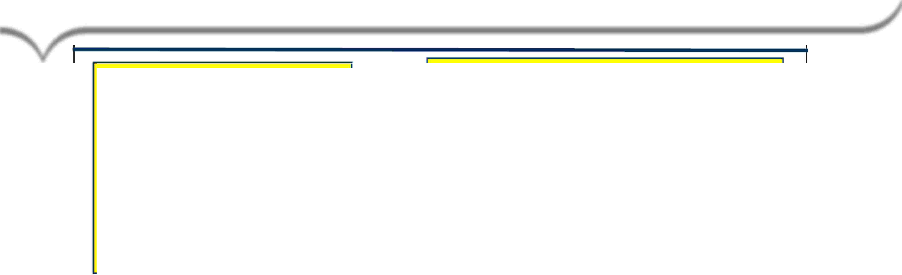
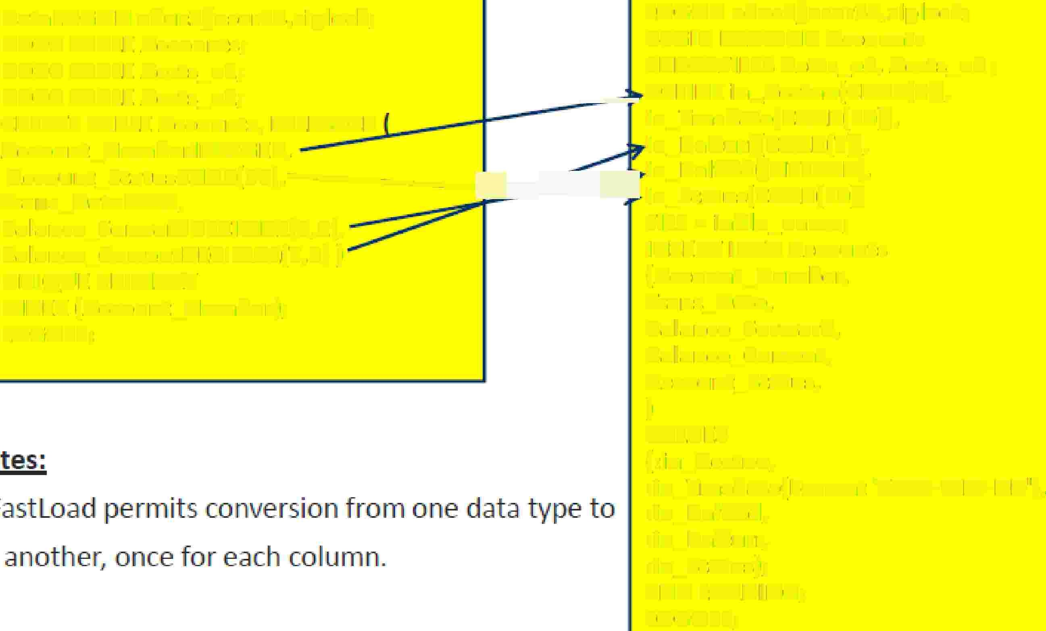


Data
Type
Conversion in Fast Load
DataLOGON educ2/user14,ziplock;
DROP TABLE Accounts; DROP TABLE Accts_el; DROP TABLE Accts_e2;
CREATE TABLE Accounts, FALLBACK Account_Numberl NTEG ER,
LOGON educ2/user14,ziplock;
BEGIN LOADING Accounts
ERROR Fl LES Accts,_el, Accts_e2;
�- DEFINE in....;Acctno(CHAR(9)), in_Trnsdate(CHAR(lO)),
in_Balcurr(CHAR(7)J,
Accou nt_StatusCHAR( 15),-------bd::::;C::::f in_Balfwd(INTEGER),
Trans_DateDATE,
in_Status(CHAR(lO))
Fl LE= infile,_name; INSERT INTO Accounts (Account_Number, Trans_Date, Balance_Forward, Balance_Current, Accou nt_Status,
)
VALUES
( :i n_Acctno,
:in_Trnsdate( Format ¹YYYY-MM-DD'),
:in_Balfwd,
:in_Balcurr,
:in_Status); END LOADING; LO GOFF;
Balance_ForwardDECI MAL(S,2),
Balance_CurrentDECIMAL(7,2)) UNIQUE PRIMARY
INDEX. (Account_Number); LOG OFF;
Notes.:
,,,. FasUoad permits conversion from one data type to another, once for each column.
,Including optional column names with the INSERT
Statement provides script documentation whkh may
aid in the future when debugging or modifying the job script.
Capgemmi
CON 5 ULT I NG. TECH NOL O G Y. 0 UT 5 0 UR CI NG
Presentation Title | Date
Copyright © Capgemini 2015. All Rights Reserved 19

Slide 20



Fast
Load
Restartibilty
When the Restart ls not Posslblec-
-,/'
·./"
.,,,-
If tlhe Enror Tables are DROPPED.
If the Target Table is DROPPED. If the Log Table is DROPPED.
When the Restart ls Posslb e:-
If an of the following cond itions are true, then Fast load is Al WAYS restartable:
-,/'
-,/'
v'
-,/'
The Error Ta biles are NOT DROPPED in the script.
The Target Table is NOT DROPPED in the script.
The Target Table is NOT CREATED
You have defined a checkpoint.
in the script,
Capgemmi
CON 5 ULT I NG. TECH NOL O G Y. 0 UT 5 0 UR CI NG
Presentation Title | Date
Copyright © Capgemini 2015. All Rights Reserved 20

Slide 21

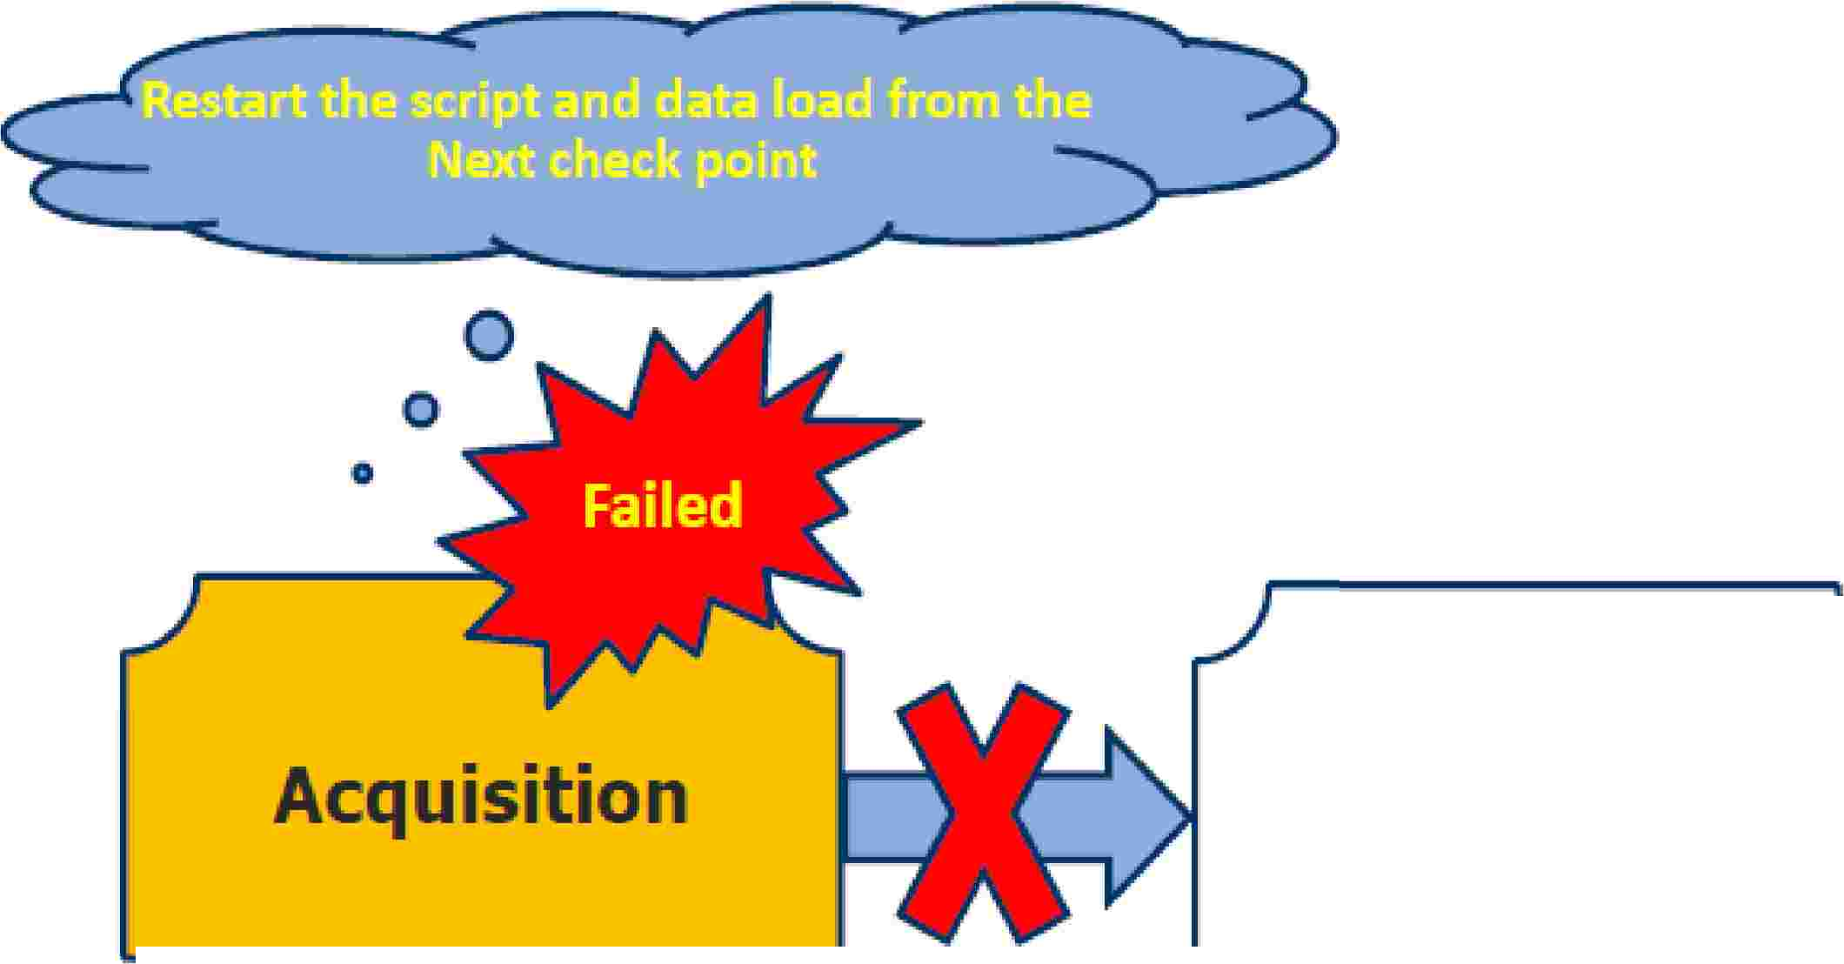



Fast
Load
Restartibilty
Acquisition
Application
F,ailed in A.1cqu'isit:ion Phase
Capgemmi
CON 5 ULT I NG. TECH NOL O G Y. 0 UT 5 0 UR CI NG
Presentation Title | Date
Copyright © Capgemini 2015. All Rights Reserved 21

Slide 22

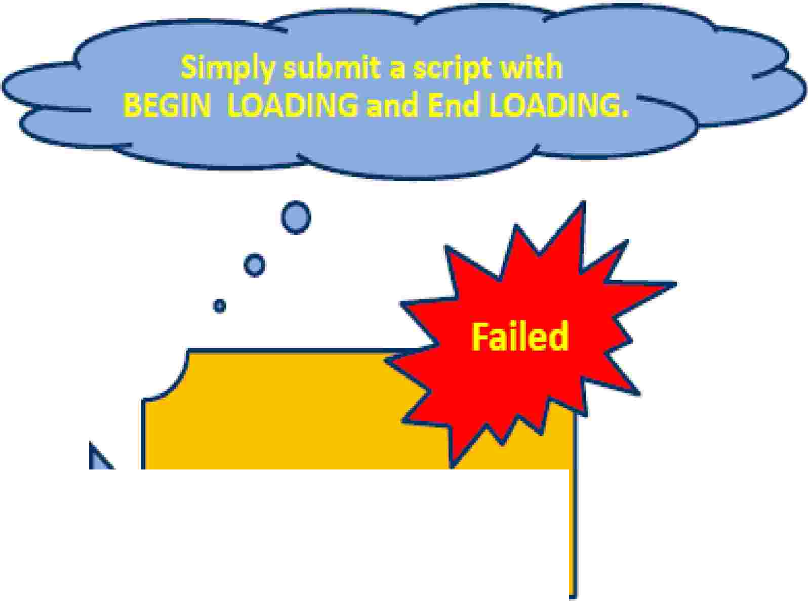
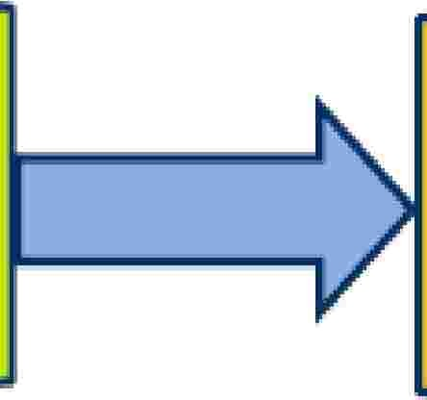



Fast
Load
Restartibilty
•
Acquisition
Application
Failed in A.pplication Phase
Capgemmi
CON 5 ULT I NG. TECH NOL O G Y. 0 UT 5 0 UR CI NG
Presentation Title | Date
Copyright © Capgemini 2015. All Rights Reserved 22

Slide 23
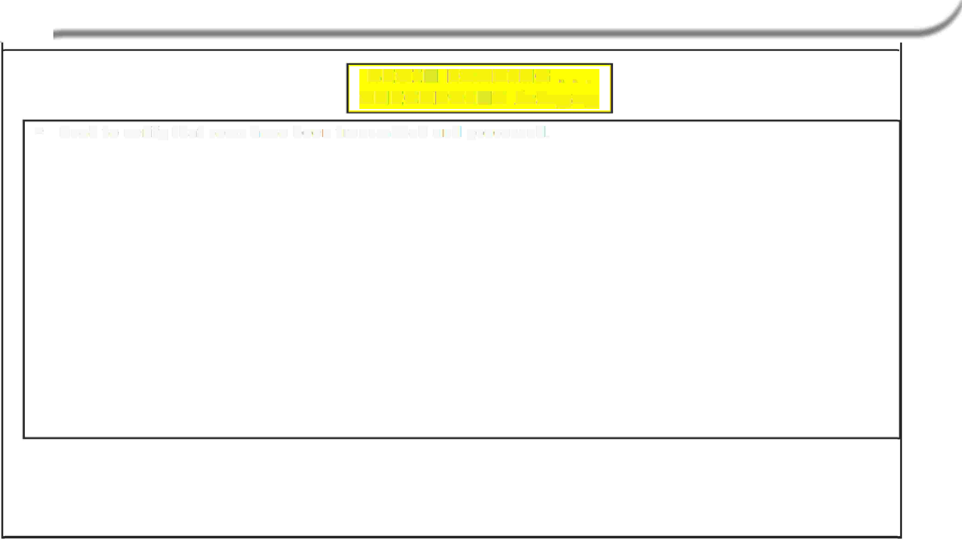


CHECKPOINT Option
BEGIN] LOADING ....
CHECKPOINIT integer;
Used to ve1ri1fy that rows have been transmrtted and processed.
•
•
Specifies tllhe number of rows transmitted before pausing to take a checkpoint and verify receipt by AMPs.
•
f the CHECKPOINT parameter is not specified, Fastload takes checkpoints as follows:
Beginning of Phase 1
Every 100.,000 input records
End of Phase 1
•
•
Fastl.oari can be restarted from previous checkpoint.
Performance Note: Checkpoints slow Fastload
p,rocessi1ng-· set the CHECKPO NT lllarge enough that
checkpoints are taken
than 100:,000.
every 10 to
15
minutes.
Usiuallly:r this requires a CHECKPOI
T value much larger
Capgemmi
CON 5 ULT I NG. TECH NOL O G Y. 0 UT 5 0 UR CI NG
Presentation Title | Date
Copyright © Capgemini 2015. All Rights Reserved 23

Slide 24

Restarting FastLoad
Condition 1.: Abort in Phas,e 1 - data acquisition incomplete.
S,olution: Resiubmi1t the script. FastLoad wm begin from record 1 or the first record past the last checkpoint.
Condition 2: Abort occurs in Phas,e 2 - data acquisition complete,
Solution: Submit on�y BEGIN and END LOADING statements: restarts Phase 2 only.
Condition .3: Normal end of Phasie l 1(paused) - more data to acquir1e�. thus there is no 'END LOADING¹ staternerst in
scrlpt ..
S,olution: Resubmit the adjusted script witllh new data file name. FastLoad wil�I be positioned to record 1 or tllhe first record past the last checkpoint.
Condition 4: Normal end of Phasie 1 (paused)-· no more data to acquir1e, no 'END LOAD NG¹ staternerrt was in the
scrlpt ..
S,olution: Submit
B,EG N
and
END LOADING statements;
restarts Phase 2 only.
Capgemmi
CON 5 ULT I NG. TECH NOL O G Y. 0 UT 5 0 UR CI NG
Presentation Title | Date
Copyright © Capgemini 2015. All Rights Reserved 24

Slide 25
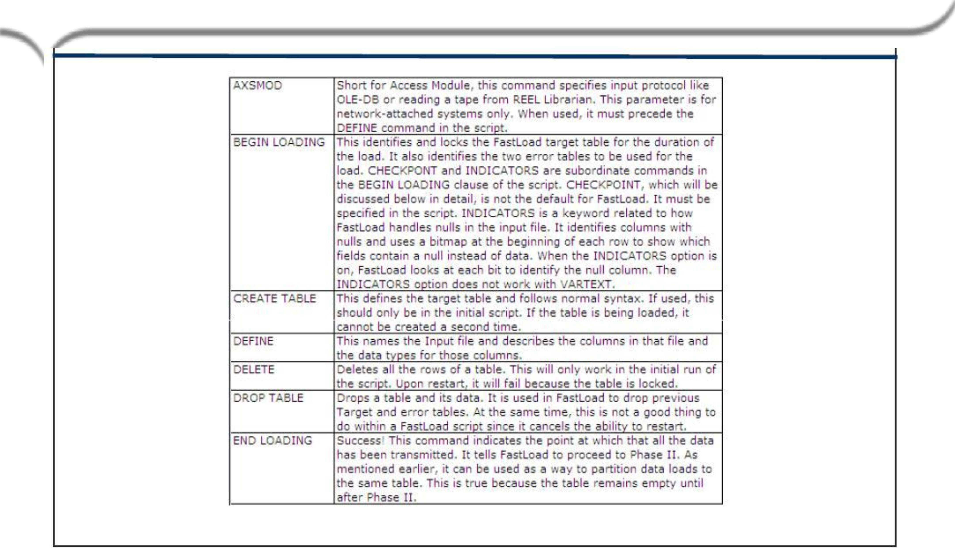

Fast
Load
Command
Capgemmi
CON 5 ULT I NG. TECH NOL O G Y. 0 UT 5 0 UR CI NG
Presentation Title | Date
Copyright © Capgemini 2015. All Rights Reserved 25

Slide 26
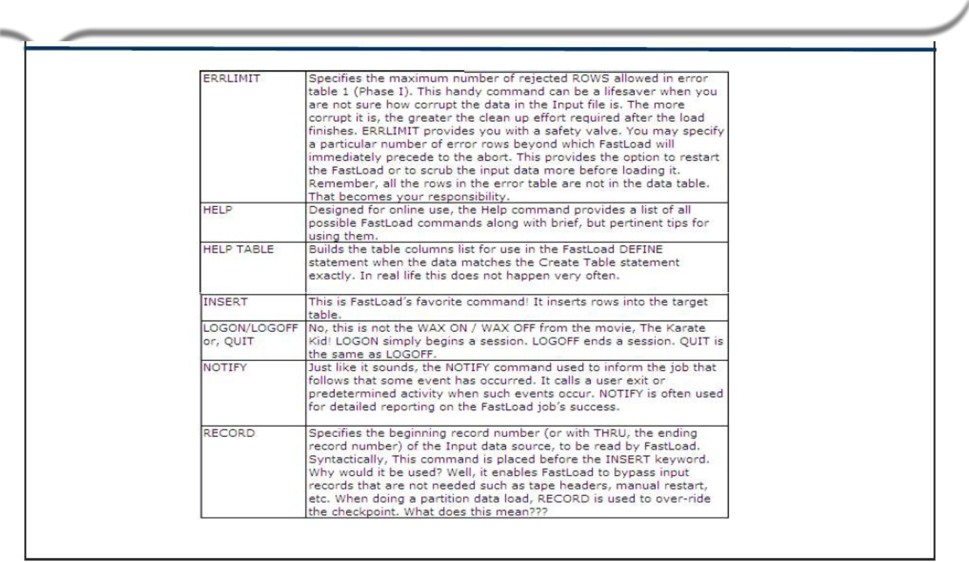
Fast
Load
Command
Capgemmi
CON 5 ULT I NG. TECH NOL O G Y. 0 UT 5 0 UR CI NG
Presentation Title | Date
Copyright © Capgemini 2015. All Rights Reserved 26

Slide 27

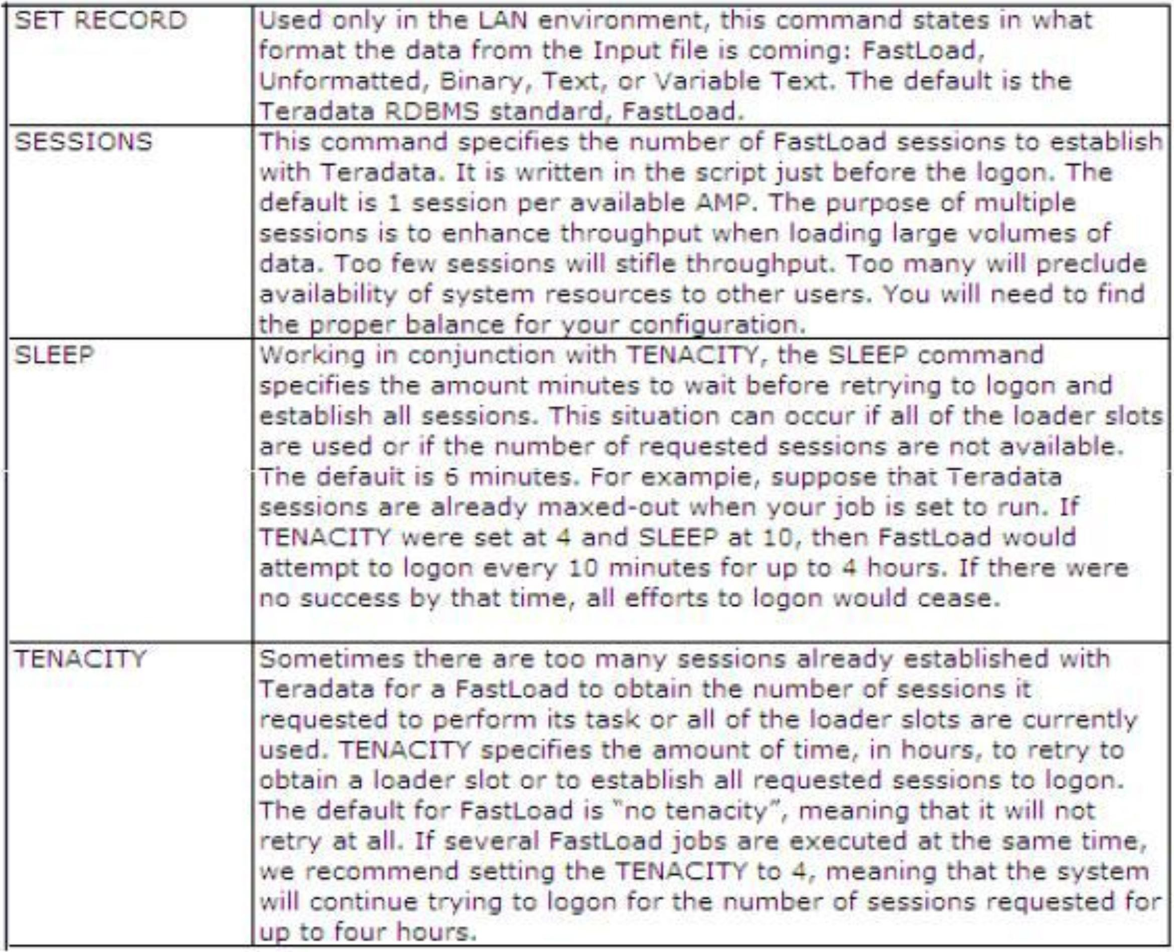
Fast Load Command
Capgemmi
CON 5 ULT I NG. TECH NOL O G Y. 0 UT 5 0 UR CI NG
Presentation Title | Date
Copyright © Capgemini 2015. All Rights Reserved 27

Slide 28
Summary
▪
FastLoad Features and Characteristics:
•
•
•
Excellent utility for loading new tables from the host or server.
Loads into an empty table with no secondary indexes.
Can reload previously emptied tables
– Remove referential integrity or secondary indexes prior
Full Restart capability
Has two phases - creates an error table for each phase.
– Error Limits and Error Tables, accessible using SQL
to
using
FastLoad.
•
•
Presentation Title | Date
Copyright © Capgemini 2015. All Rights Reserved 28

Slide 29
Q
&
A
Presentation Title | Date
Copyright © Capgemini 2015. All Rights Reserved 29

Slide 30
Review Questions
▪ Match the item in the first column to a corresponding statement in the second
column.
1. Phase 1
A. Might be used if a zero date causes an error
2. CHECKPOINT
B. Table status required for loading with FastLoad
3. ERRORTABLE1
C. Records written in unsorted blocks
4. ERRORTABLE2
D. Records rows with duplicate values for UPI
5. Empty Table
E. Not permitted on table to be loaded with FastLoad
6. Secondary Index
F. Points FastLoad to a record in an input file
7. Conversion
G. Can be used to restart loading from a given point
8. NULLIF
H. Records constraint violations
9. RECORD
I. Builds the actual table blocks for the new table
10. Phase 2
J. Transform one data type to another, once per column
Presentation Title | Date
Copyright © Capgemini 2015. All Rights Reserved 30

Slide 31
Review Question Answers
▪
Match the item in the first column to a corresponding statement in the second column.
1. _C_ Phase 1
A. Might be used if a zero date causes an error
2. _G_ CHECKPOINT
B. Table status required for loading with FastLoad
3. _H_ ERRORTABLE1
C. Records written in unsorted blocks
4. _D_ ERRORTABLE2
D. Records rows with duplicate values for UPI
5. _B_ Empty Table
E. Not permitted on table to be loaded with FastLoad
6. _E_ Secondary Index
F. Points FastLoad to a record in an input file
7. _J_ Conversion
G. Can be used to restart loading from a given point
8. _A_ NULLIF
H. Records constraint violations
9. _F_ RECORD
I. Builds the actual table blocks for the new table
10. _I Phase 2
J. Transform one data type to another, once per column
Presentation Title | Date
Copyright © Capgemini 2015. All Rights Reserved 31

Slide 32
Lab Exercise Fast_Load
3-1
Purpose
In this lab, you will set up a restartable FastLoad operation.
What you need
There are two data file that contains customer data. You have to load those two data file into your empty
customer table through two BTEQ scripts.
Tasks
2. Create a FastLoad script that loads the first 15 records (data3_1 file) and do not include the END
LOADING statement in this script.
3. Create a FastLoad script that loads the additional 20 records (data3_2) and complete the FastLoad.
4. Check the result. (Your Customer table should contain 35 rows.)
Presentation Title | Date
Copyright © Capgemini 2015. All Rights Reserved 32

Slide 33










Lab
Solutions
for Lab 3-1
Ila b312.f11d
LOGON U I D/PASS:,l[)ata base;
lab313.fM
LOGON UID/PASS:,Database;
BEGIN LOADIING Customer
ER RDR Fil LES cust:_e rrl, c ust:_err2 ;
BEGIN LOADIING Customer
ERROR Fii LIES cust:_errl, cust:_err2;
DEFINE
in cust
in-lname
in=fname
(IINT!E¹GER).,.
(CHAR(30)1) .. (CHAR(20)¹) ..
DEFINE in cust
(II NTE¹GER).,.
- in_lname
in_fname
(CIHAR(30)1) ..
(CHAR(20)i) ..
FILE=: data3_1;:
!INSERT INTO Customer
!FILE=: data3_2;
!INSERT INTO Customer
VALUES ( :in_cust..
:in lname,
:'in:)name);
VAILUES
(
:in_icust..
:in lnarne,
:in=fname);
LOGO FF;
END LOADING;
LOGO FF;
fastload < lab3,12.fld
fastload
< lab313.fld
Presentation Title | Date
Copyright © Capgemini 2015. All Rights Reserved 33

Slide 34
Contact
information
Insert contact picture
Name
Last Name Title/Role name.lastname@capgemini.com
Insert contact picture
Name
Last Name Title/Role name.lastname@capgemini.com
Capgemini Office (Optional)
Address Line 1
Address Line 2
Address Line 3
Capgemini Office (Optional)
Address Line 1
Address Line 2
Address Line 3
Insert contact picture
Name
Last Name Title/Role name.lastname@capgemini.com
Insert contact picture
Name
Last Name Title/Role name.lastname@capgemini.com
Capgemini Office (Optional)
Address Line 1
Address Line 2
Address Line 3
Capgemini Office (Optional)
Address Line 1
Address Line 2
Address Line 3
Presentation Title | Date
Copyright © Capgemini 2015. All Rights Reserved 34

Slide 35




About Capgemini
With almost 145,000 people in over 40 countries, Capgemini is one of the world's foremost providers of consulting, technology and outsourcing services. The Group reported 2014 global revenues of EUR 10.573 billion.
Together with its clients, Capgemini creates and delivers business and technology solutions that fit their needs and drive the results they want. A deeply multicultural organization, Capgemini has developed its own way of working, the Collaborative Business Ex perienc e™ , and draws on Rightshore®,
its worldwide delivery model.
Learn more about us at www.capgemini.com.
www.capgemini.com
The information contained in this presentation is proprietary.
Copyright © 2015 Capgemini. All rights reserved. Rightshore® is a trademark belonging to Capgemini.

